Slide 1

ACADEMIC WRITING
WEEK 6
NORLIDA ARIFFIN

Slide 2
Argumentative essay
The purpose of an argumentative essay is to establish a stance or position on an issue by providing reasons and supporting evidence. A well written argumentative essay will:
Introduce a compelling topic and engage the reader;
Explain and consider all sides of an issue fairly;
Address any potential counterarguments to the writer’s perspective; and
Persuade the reader to adopt or consider a new perspective.

Slide 3
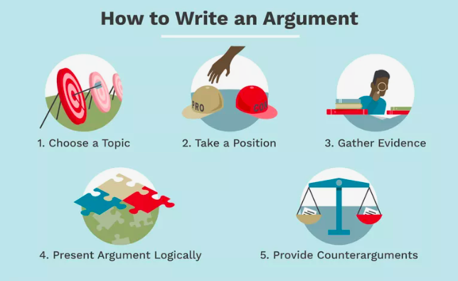

Slide 4
What should a good argumentative essay have?
A clear thesis statement in the introduction.
Logical reasoning and points which support the thesis statement.
Relevant examples or evidence which support the points.

Slide 5
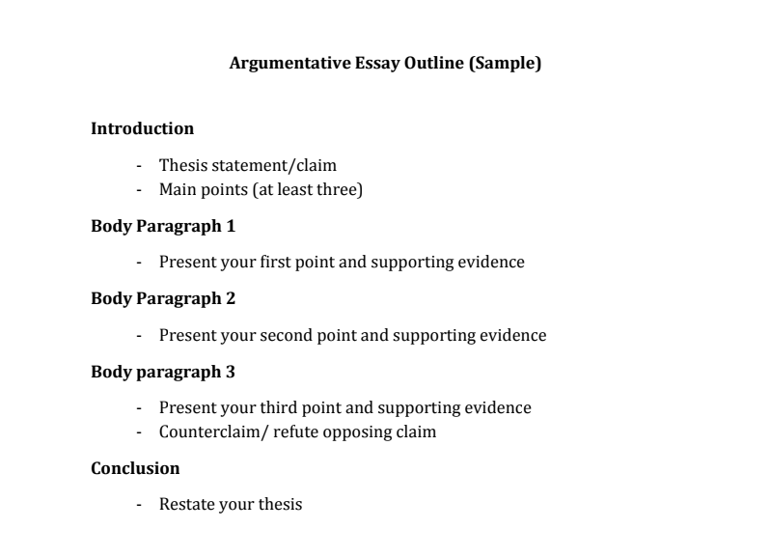
The outline

Slide 6
First paragraph- Introduction
A hook
Background information
Thesis statement

Slide 7
Step 1: Hook your reader
Your first sentence sets the tone for the whole essay, so spend some time on writing an effective hook.
A “hook”- a sentence that grabs your reader’s attention.
Avoid long, dense sentences—start with something clear, concise and catchy that will spark your reader’s curiosity.
The hook should lead the reader into your essay, giving a sense of the topic you’re writing about and why it’s interesting. Avoid overly broad claims or plain statements of fact.

Slide 8
Tips on writing a good hook

Slide 9
Examples of hooks
Question: What is the difference between unsuccessful college students and successful college students?
Statement: In-person college classes are more effective than online college classes.
Fact/statistical: According to the National Soft Drink Association, the annual consumption of soda by the U.S. citizens is 600 cans.
Simile: Writing a research paper is like running a marathon blindfolded.
Quotation: “An investment in knowledge pays the best interest”.
Description: The dog howled in pain and limped along the side of the road. His leg was cut, and blood streamed down his leg.
Story: John was 6 when he lost his father. Watching him die on the ventilator changed the meaning of life for him forever.

Slide 10
Background information on your topic
Try to answer the following questions:
What is the issue at hand?
Who cares?
Where is this issue important?
Why is it important?
What are the root causes of this problem?
Are there any solutions available?
What can or should be done about it?

Slide 11
Thesis statement
You must convince your reader that your position on the issue is valid.
Your thesis statement must be logical and reasonable. Clearly, if you want your reader to “listen” to what you have to say, you need to show that you have thought out your argument from ALL angles.
You will give your opinion WITHOUT using 1st person
Your thesis statement should be DEBATABLE (someone else may disagree with you)

Slide 12
Tips on thesis writing:
A thesis evolves as you work with your topic. Brainstorm, research, talk, and think about your topic before settling on a thesis. If you are having trouble formulating a thesis, begin freewriting about your topic. Your freewrite may suggest a workable thesis.
During the writing process, consider your thesis a working thesis and be willing to modify and re-focus it as you draft and revise your paper.

Slide 13
What makes a good thesis statement?
Concise
A good thesis statement is short and sweet—don’t use more words than necessary. State your point clearly and directly in one or two sentences.
Contentious
Your thesis shouldn’t be a simple statement of fact that everyone already knows. A good thesis statement is a claim that requires further evidence or analysis to back it up.
Particularly in an argumentative essay, your thesis statement should be something that others might question or disagree with.
Coherent
Your thesis statement might mention several aspects of your topic, but they should all add up to a coherent whole, expressing one main idea.
Everything mentioned in your thesis statement must be supported and explained in the rest of your paper.

Slide 14
Avoid writing a thesis statement that:
A thesis expressed as a fragment.
A thesis which is too broad.
A thesis worded as a question.
A thesis which includes extraneous information.
A thesis which begins with I think or in my opinion.
A thesis which deals with a stale or lame issue.
A thesis which contains words which lead to faulty generalizations (all, none, always, only, everyone, etc.)

Slide 19

GROUP DISCUSSION
In group, pick a topic of your interest.
Choose your stand.
Gather evidence to support your stand. Provide examples and explanations.
Come out with an interesting mind map.

Slide 20
References
https://studylib.net/doc/9214476/argumentative-essay-notes
https://www.scribbr.com/academic-essay/introduction/
https://www.essayjack.com/blog/building-an-argumentative-essay-step-by-step
https://www.thoughtco.com/write-an-argument-essay-1856986
https://www.scribbr.com/academic-essay/thesis-statement/

